Slide 1
Digital Logic Design
Lecture 14
Chapter 3 ‹#›

Slide 2
Decoding
Decoding - the conversion of an n-bit input code to an m-bit output code with n ≤ m ≤ 2^{n} such that each valid code word produces a unique output code
Circuits that perform decoding are called decoders
Here, functional blocks for decoding are
called n-to-m line decoders, where m ≤ 2^{n}, and
generate 2^{n} (or fewer) minterms for the n input variables
Chapter 3 ‹#›

Slide 3
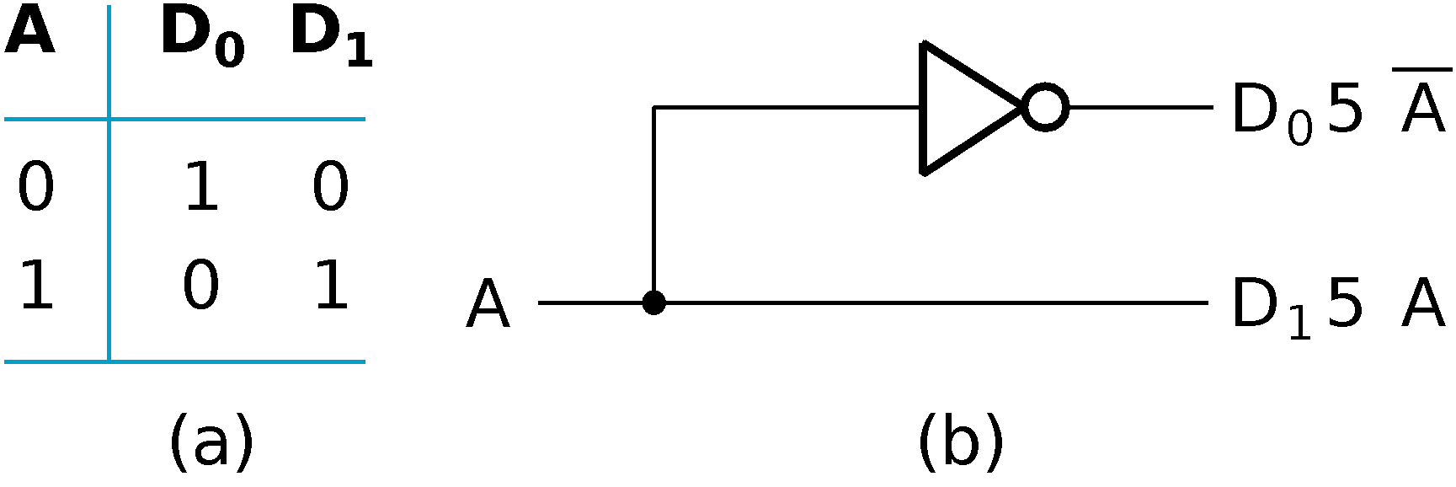
Decoder Examples
1-to-2-Line Decoder
2-to-4-Line Decoder
A
0
A
1
A
0
D
0
D
1
D
2
D
3
A
1
0
0
1
0
0
0
D
=
A
A
0
1
0
1
0
0
0
1
0
1
0
0
0
1
0
1
1
0
0
0
1
D
1
=
A
1
A
0
(a)
D
2
=
A
1
A
0
Note that the 2-4-line made up of 2 1-to-2- line decoders and 4 AND gates.
D
3
=
A
1
A
0
(b)
Chapter 3 ‹#›

Slide 4
Decoder Expansion
General procedure given in book for any decoder with n inputs and 2^{n} outputs.
This procedure builds a decoder backward from the outputs.
The output AND gates are driven by two decoders with their numbers of inputs either equal or differing by 1.
These decoders are then designed using the same procedure until 2-to-1-line decoders are reached.
The procedure can be modified to apply to decoders with the number of outputs ≠ 2^{n}
Chapter 3 ‹#›

Slide 5
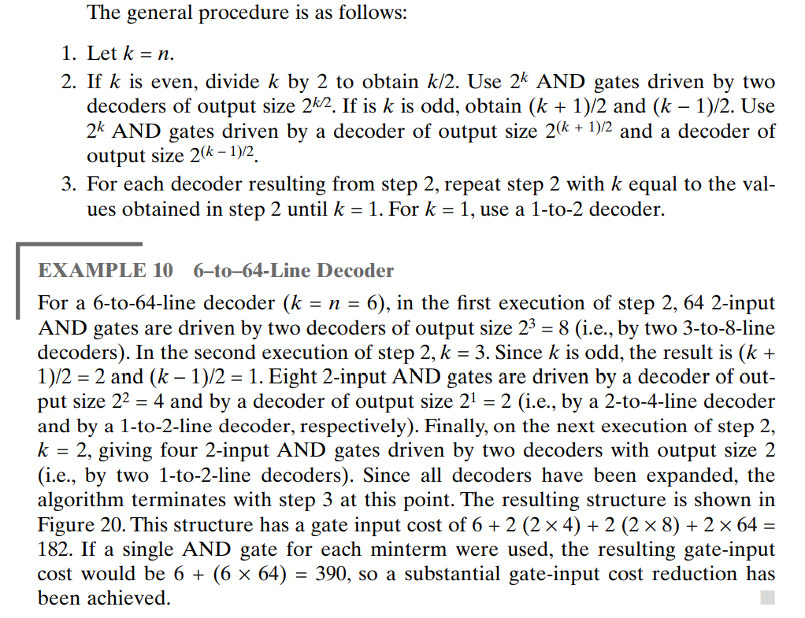
Chapter 3 ‹#›

Slide 6
Decoder Expansion - Example 1
3-to-8-line decoder
Number of output ANDs = 8
Number of inputs to decoders driving output ANDs = 3
Closest possible split to equal
2-to-4-line decoder
1-to-2-line decoder
2-to-4-line decoder
Number of output ANDs = 4
Number of inputs to decoders driving output ANDs = 2
Closest possible split to equal
Two 1-to-2-line decoders
See next slide for result
Chapter 3 ‹#›

Slide 7
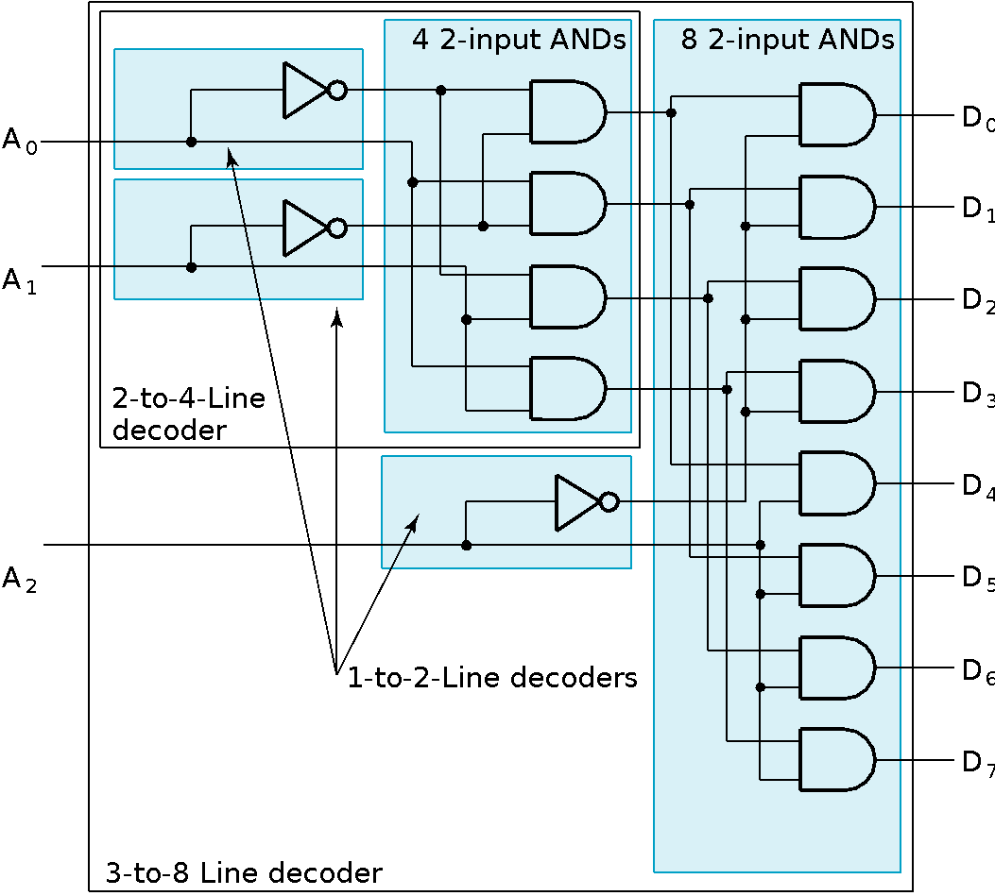
Decoder Expansion - Example 1
Result
Chapter 3 ‹#›

Slide 8
Decoder Expansion - Example 2
7-to-128-line decoder
Number of output ANDs = 128
Number of inputs to decoders driving output ANDs = 7
Closest possible split to equal
4-to-16-line decoder
3-to-8-line decoder
4-to-16-line decoder
Number of output ANDs = 16
Number of inputs to decoders driving output ANDs = 2
Closest possible split to equal
2 2-to-4-line decoders
Complete using known 3-8 and 2-to-4 line decoders
Chapter 3 ‹#›

Slide 9
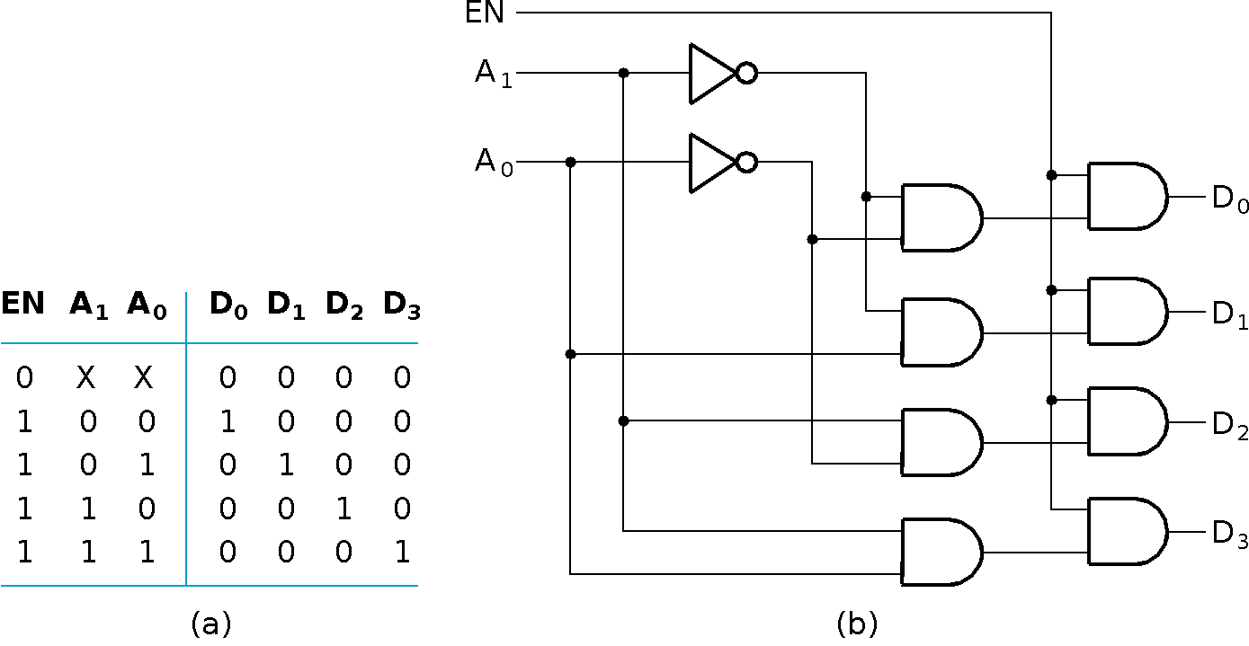
Decoder with Enable
In general, attach m-enabling circuits to the outputs
See truth table below for function
Note use of X’s to denote both 0 and 1
Combination containing two X’s represent four binary combinations
Alternatively, can be viewed as distributing value of signal EN to 1 of 4 outputs
In this case, called a demultiplexer
Chapter 3 ‹#›

Slide 10
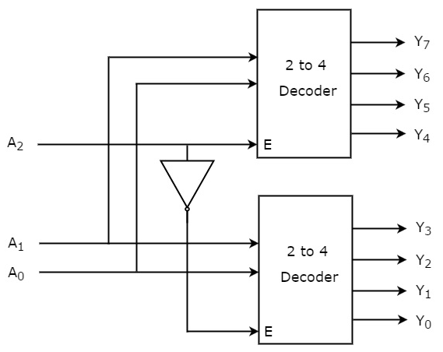
3 to 8 line decoder using 2 to 4 line decoder(s)
Chapter 3 ‹#›

Slide 11
3 to 8 line decoder using 2 to 4 line decoder(s)
The parallel inputs A₁ & A₀ are applied to each 2 to 4 decoder.
The complement of input A₂ is connected to Enable, E of lower 2 to 4 decoder in order to get the outputs, Y₃ to Y₀. These are the lower four min terms.
The input, A₂ is directly connected to Enable, E of upper 2 to 4 decoder in order to get the outputs, Y₇ to Y₄. These are the higher four min terms.
Chapter 3 ‹#›

Slide 12
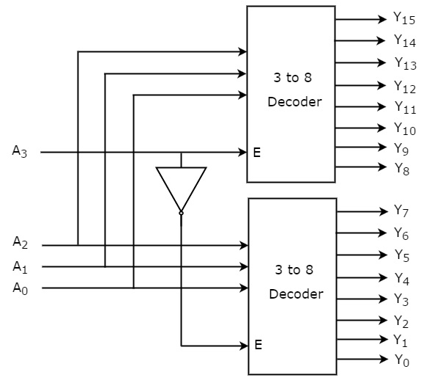
4 to 16 decoder using 3 to 8 decoders
Chapter 3 ‹#›

Slide 13
Decoder-Based Combinational Circuits
A decoder provides the 2^{n} minterms of n input variables.
Since any Boolean function can be expressed as a sum of minterms, one can use a decoder to generate the minterms and combine them with an external OR gate to form a sum-of-minterms implementation.
A combinational circuit with n inputs and m outputs can be implemented with an n–to–2^{n}-line decoder and m OR gates.
Chapter 3 ‹#›

Slide 14
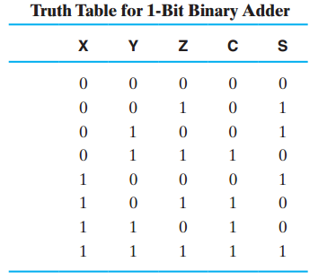
Binary adder Bit using Decoder and OR gate
_{S(X, Y, Z) = Σm(1, 2, 4, 7)} _{C(X, Y, Z ) = Σm(3, 5, 6, 7)}
Chapter 3 ‹#›

Slide 15
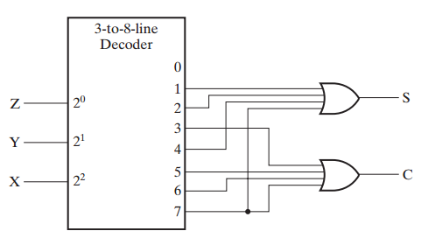
Circuit Diagram
Chapter 3 ‹#›

Slide 16
Encoding
Encoding - the opposite of decoding - the conversion of an m-bit input code to a n-bit output code with n ≤ m ≤ 2^{n} such that each valid code word produces a unique output code
Circuits that perform encoding are called encoders
An encoder has 2^{n} (or fewer) input lines and n output lines which generate the binary code corresponding to the input values
Typically, an encoder converts a code containing exactly one bit that is 1 to a binary code corres-ponding to the position in which the 1 appears.
Chapter 3 ‹#›

Slide 17
Encoder Example
A decimal-to-BCD encoder
Inputs: 10 bits corresponding to decimal digits 0 through 9, (D₀, …, D₉)
Outputs: 4 bits with BCD codes
Function: If input bit D_{i} is a 1, then the output (A₃, A₂, A₁, A₀) is the BCD code for i,
The truth table could be formed, but alternatively, the equations for each of the four outputs can be obtained directly.
Chapter 3 ‹#›

Slide 18
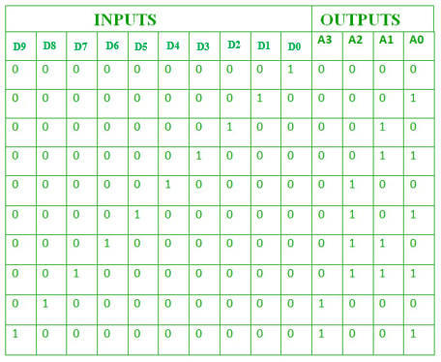
Decimal to BCD Encoder
Chapter 3 ‹#›

Slide 19
Encoder Example (continued)
Input D_{i} is a term in equation A_{j} if bit A_{j} is 1 in the binary value for i.
Equations:
A₃ = D₈ + D₉
A₂ = D₄ + D₅ + D₆ + D₇
A₁ = D₂ + D₃ + D₆ + D₇
A₀ = D₁ + D₃ + D₅ + D₇ + D₉
F₁ = D₆ + D₇ can be extracted from A₂ and A₁ Is there any cost saving?
Chapter 3 ‹#›
Notes:
No. The total gate input cost remains the same.

Slide 20
Priority Encoder
If more than one input value is 1, then the encoder just designed does not work.
One encoder that can accept all possible combinations of input values and produce a meaningful result is a priority encoder.
Among the 1s that appear, it selects the most significant input position (or the least significant input position) containing a 1 and responds with the corresponding binary code for that position.
Chapter 3 ‹#›

Slide 21
Priority Encoder Example
Priority encoder with 5 inputs (D₄, D₃, D₂, D₁, D₀) - highest priority to most significant 1 present - Code outputs A2, A1, A0 and V where V indicates at least one 1 present.
Xs in input part of table represent 0 or 1; thus table entries correspond to product terms instead of minterms. The column on the left shows that all 32 minterms are present in the product terms in the table
No. of Min-terms/Row | Inputs |  |  |  |  | Outputs
 | D4 | D3 | D2 | D1 | D0 | A2 | A1 | A0 | V
1 | 0 | 0 | 0 | 0 | 0 | X | X | X | 0
1 | 0 | 0 | 0 | 0 | 1 | 0 | 0 | 0 | 1
2 | 0 | 0 | 0 | 1 | X | 0 | 0 | 1 | 1
4 | 0 | 0 | 1 | X | X | 0 | 1 | 0 | 1
8 | 0 | 1 | X | X | X | 0 | 1 | 1 | 1
16 | 1 | X | X | X | X | 1 | 0 | 0 | 1
Chapter 3 ‹#›
Notes:
Go over table explaining how entries were obtained, particularly those containing Xs

Slide 22
Priority Encoder Example (continued)
Could use a K-map to get equations, but can be read directly from table and manually optimized if careful:
A₂ = D₄
A₁ = D₃ + D₂ = F₁, F₁ = (D₃ + D₂)
A₀ = D₃ + D₁ = (D₃ + D1)
V = D₄ + F₁ + D₁ + D₀
D₄
D₄
D₃
D₄
D₄
D₄
D₃
D₂
D₄
D₂
Chapter 3 ‹#›

Slide 23
Selecting
Selecting of data or information is a critical function in digital systems and computers
Circuits that perform selecting have:
A set of information inputs from which the selection is made
A single output
A set of control lines for making the selection
Logic circuits that perform selecting are called multiplexers
Selecting can also be done by three-state logic or transmission gates
Chapter 3 ‹#›

Slide 24
Multiplexers
A multiplexer selects information from an input line and directs the information to an output line
A typical multiplexer has n control inputs (S_{n − 1}, … S₀) called selection inputs, 2^{n} information inputs (I₂^{n} ₋ ₁, … I₀), and one output Y
A multiplexer can be designed to have m information inputs with m < 2^{n} as well as n selection inputs
Chapter 3 ‹#›

Slide 25
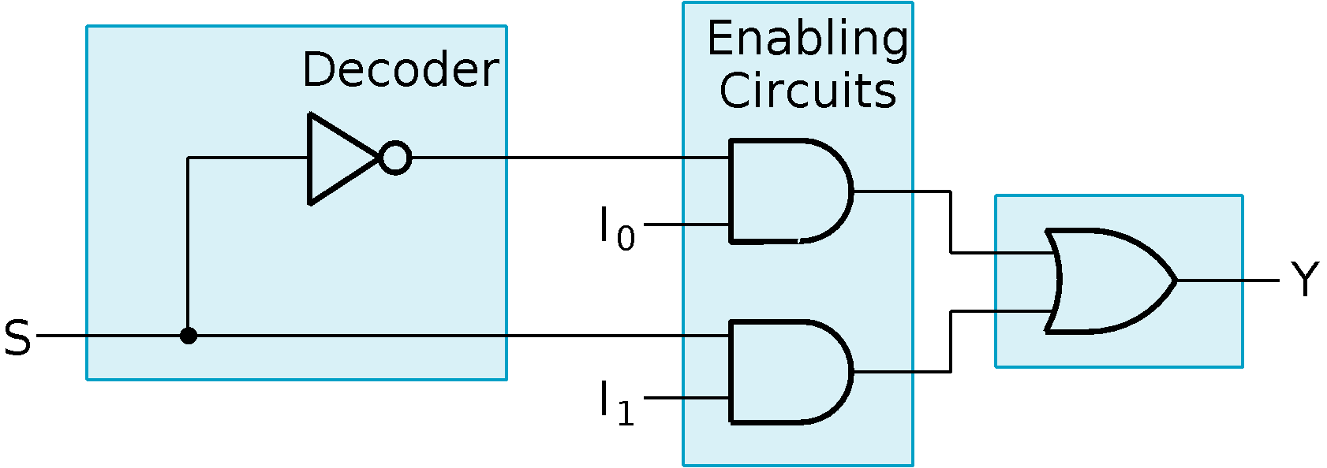
2-to-1-Line Multiplexer
Since 2 = 2¹, n = 1
The single selection variable S has two values:
S = 0 selects input I₀
S = 1 selects input I₁
The equation:
Y = I₀ + SI₁
The circuit:
S
Chapter 3 ‹#›

Slide 26
2-to-1-Line Multiplexer (continued)
Note the regions of the multiplexer circuit shown:
1-to-2-line Decoder
2 Enabling circuits
2-input OR gate
To obtain a basis for multiplexer expansion, we combine the Enabling circuits and OR gate into a 2 × 2 AND-OR circuit:
1-to-2-line decoder
2 × 2 AND-OR
In general, for an 2^{n}-to-1-line multiplexer:
n-to-2^{n}-line decoder
2^{n} × 2 AND-OR
Chapter 3 ‹#›

Slide 27
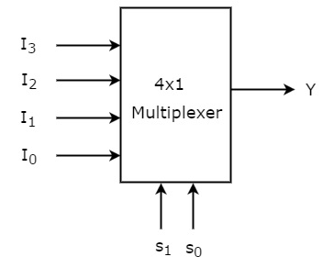
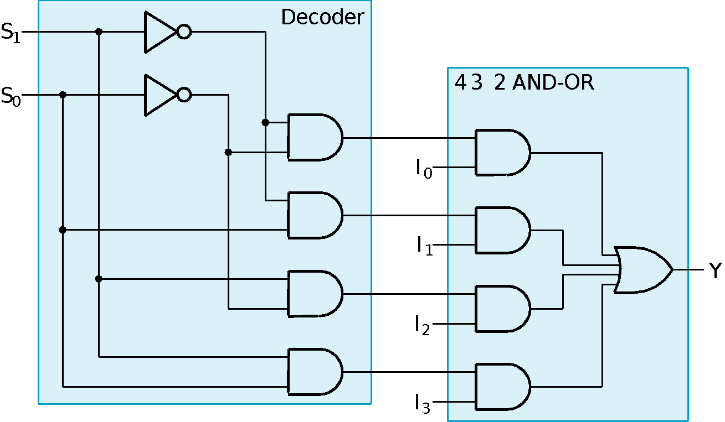
Example: 4-to-1-line Multiplexer
2-to-2²-line decoder
2² × 2 AND-OR
Chapter 3 ‹#›

Slide 28
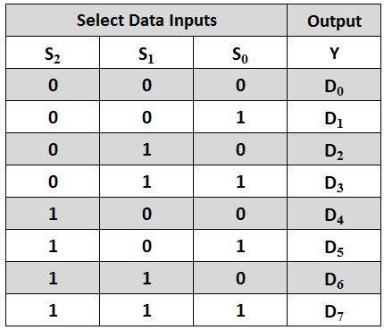
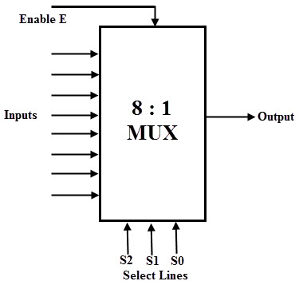
Example: 8-to-1-line Multiplexer
Chapter 3 ‹#›

Slide 29
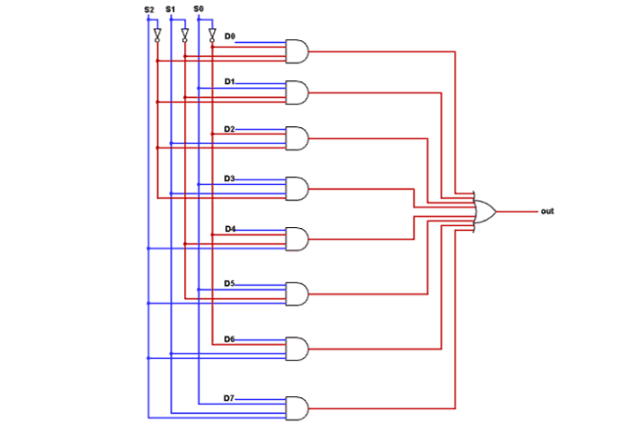
Example: 8-to-1-line Multiplexer
Chapter 3 ‹#›

Slide 30
Multiplexer Expansion
8-to-1 MUX using Dual 4-to-1 MUX
_{MUX}
_{I0}
_{I1}
_{I2}
_{I3}
_{I4}
_{I5}
_{I6}
_{I7}
_{I0}
_{I1}
_{I2}
_{I3}
_{Y}
_{S1 S0}
_{MUX}
_{I0}
_{I1}
_{Y}
_{Y}
_{MUX}
_{S}
_{I0}
_{I1}
_{I2}
_{I3}
_{Y}
_{S1 S0}
₁
₀ ₀
_{S2 S1 S0}
Notes:
Princess Sumaya University
4241 - Digital Logic Design
Dr. Bassam Kahhaleh
‹#›

Slide 31
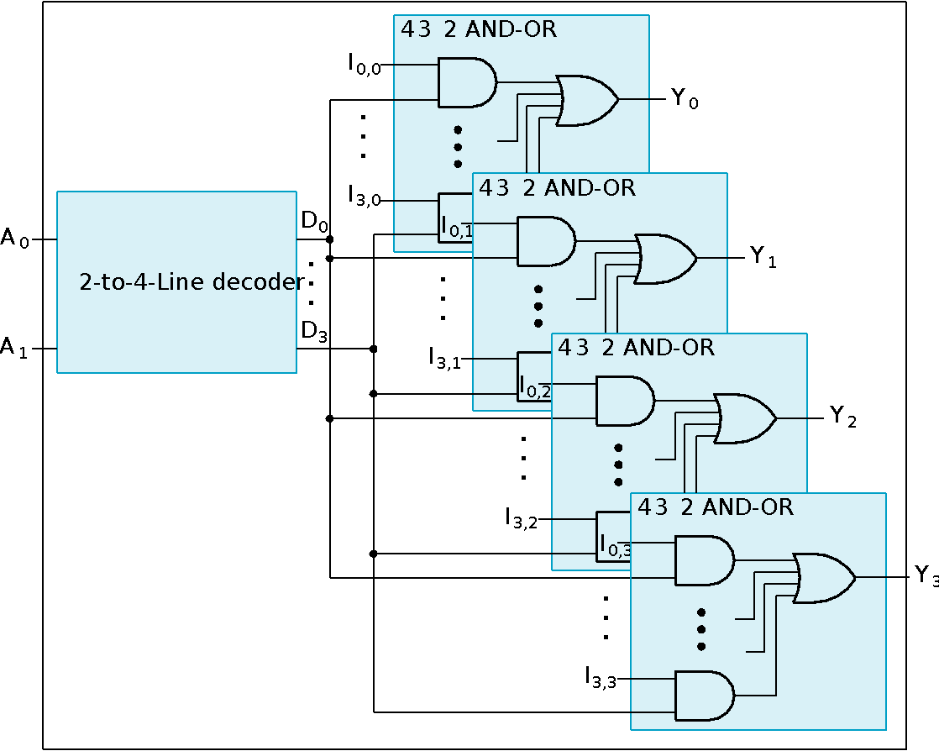
Multiplexer Width Expansion
Select “vectors of bits” instead of “bits”
Use multiple copies of 2^{n} × 2 AND-OR in parallel
Example: 4-to-1-line quad multi- plexer
Chapter 3 ‹#›

Slide 32
Combinational Logic Implementation - Multiplexer Approach 1
Implement m functions of n variables with:
Sum-of-minterms expressions
An m-wide 2^{n}-to-1-line multiplexer
Design:
Find the truth table for the functions.
In the order they appear in the truth table:
Apply the function input variables to the multiplexer inputs S_{n − 1}, … , S₀
Label the outputs of the multiplexer with the output variables
Value-fix the information inputs to the multiplexer using the values from the truth table (for don’t cares, apply either 0 or 1)
Chapter 3 ‹#›

Slide 33
Example: Gray to Binary Code
Design a circuit to convert a 3-bit Gray code to a binary code
The formulation gives the truth table on the right
It is obvious from this table that X = C and the Y and Z are more complex
Gray
Binary
A B C
x y z
0
0
0
0
0
0
1 0
0
0
0 1
1
1 0
0 1 0
0 1 0
0 1
1
0 1
1
1 0
0
1
1
1
1 0 1
1 0 1
1
1 0
0
0 1
1
1
1
Chapter 3 ‹#›

Slide 34
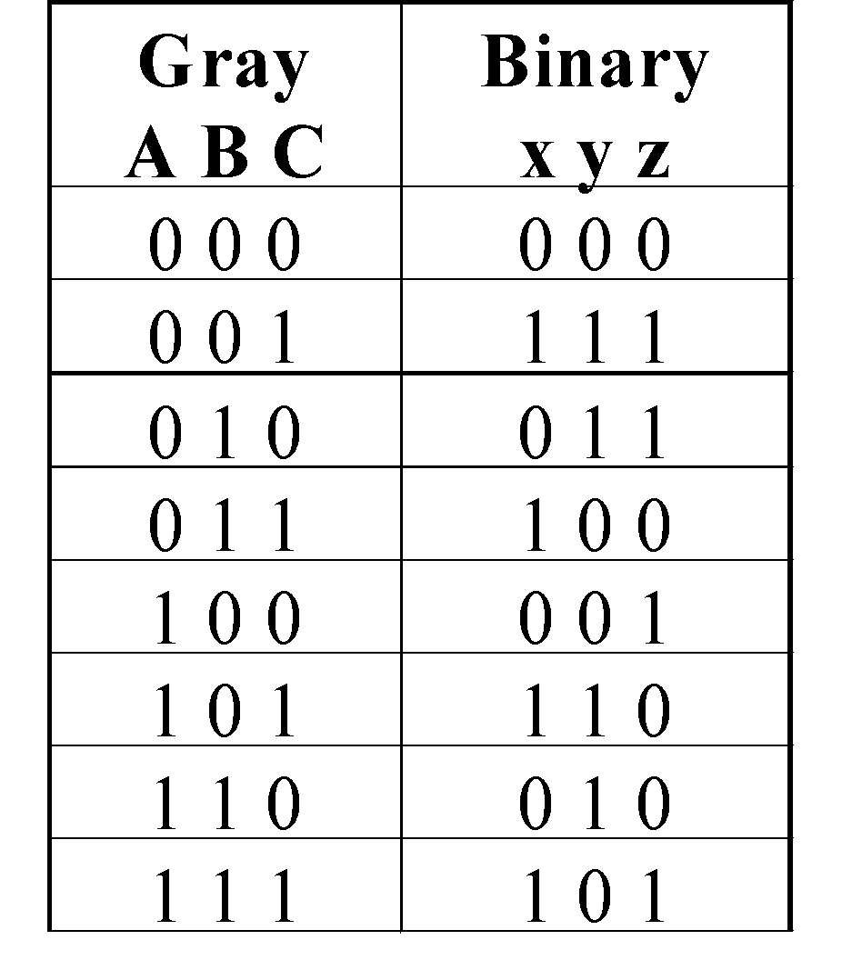
Gray to Binary (continued)
Rearrange the table so that the input combinations are in counting order
Functions y and z can be implemented using a dual 8-to-1-line multiplexer by:
connecting A, B, and C to the multiplexer select inputs
placing y and z on the two multiplexer outputs
connecting their respective truth table values to the inputs
Chapter 3 ‹#›

Slide 35
Gray to Binary (continued)
Note that the multiplexer with fixed inputs is identical to a ROM with 3-bit addresses and 2-bit data!
0
D00
0
D10
1
D01
1
D11
1
D02
1
D12
0
D03
0
D13
0
D04
1
D14
1
Out
Y
0
Out
Z
D05
D15
1
D06
0
D16
0
D07
1
D17
A
S2
A
S2
8-to-1
8-to-1
B
S1
B
S1
MUX
S0
MUX
C
S0
C
Chapter 3 ‹#›

Slide 36
Combinational Logic Implementation - Multiplexer Approach 2
Implement any m functions of n + 1 variables by using:
An m-wide 2^{n}-to-1-line multiplexer
A single inverter
Design:
Find the truth table for the functions.
Based on the values of the first n variables, separate the truth table rows into pairs
For each pair and output, define a rudimentary function of the final variable (0, 1, X, )
Using the first n variables as the index, value-fix the information inputs to the multiplexer with the corresponding rudimentary functions
Use the inverter to generate the rudimentary function
X
X
Chapter 3 ‹#›

Slide 37
Example: Gray to Binary Code
Design a circuit to convert a 3-bit Gray code to a binary code
The formulation gives the truth table on the right
It is obvious from this table that X = C and the Y and Z are more complex
Gray
Binary
A B C
x y z
0
0
0
0
0
0
1 0
0
0
0 1
1
1 0
0 1 0
0 1 0
0 1
1
0 1
1
1 0
0
1
1
1
1 0 1
1 0 1
1
1 0
0
0 1
1
1
1
Chapter 3 ‹#›

Slide 38
Gray to Binary (continued)
Rearrange the table so that the input combinations are in counting order, pair rows, and find rudimentary functions
Gray A B C | Binary x y z | Rudimentary Functions of C for y | Rudimentary Functions of C for z
0 0 0 | 0 0 0
0 0 1 | 1 1 1
0 1 0 | 0 1 1
0 1 1 | 1 0 0
1 0 0 | 0 0 1
1 0 1 | 1 1 0
1 1 0 | 0 1 0
1 1 1 | 1 0 1
F = C
F = C
F = C
F = C
F = C
F = C
F = C
F = C
Chapter 3 ‹#›

Slide 39
Gray to Binary (continued)
Assign the variables and functions to the multiplexer inputs:
Note that this approach (Approach 2) reduces the cost by almost half compared to Approach 1.
This result is no longer ROM-like
Extending, a function of more than n variables is decomposed into several sub-functions defined on a subset of the variables. The multiplexer then selects among these sub-functions.
C
D00
C
D10
C
D01
C
D11
C
C
C
D02
Out
Y
C
D12
Out
Z
C
D03
C
D13
A
S1
8-to-1
A
S1
8-to-1
B
S0
MUX
B
S0
MUX
Chapter 3 ‹#›

Slide 40
Terms of Use
All (or portions) of this material © 2008 by Pearson Education, Inc.
Permission is given to incorporate this material or adaptations thereof into classroom presentations and handouts to instructors in courses adopting the latest edition of Logic and Computer Design Fundamentals as the course textbook.
These materials or adaptations thereof are not to be sold or otherwise offered for consideration.
This Terms of Use slide or page is to be included within the original materials or any adaptations thereof.
Chapter 3 ‹#›

